Slide 1
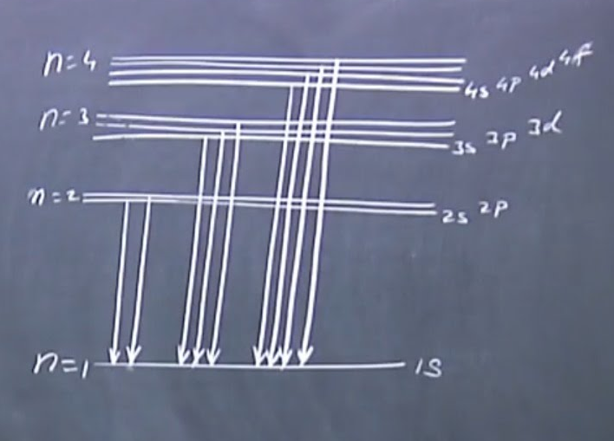
Lecture 4: Quantum numbers of Hydrogen atom

Slide 2
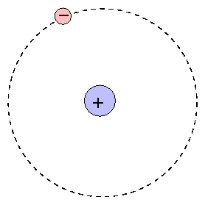
Recapitulation: Separation of variables in the Schrödinger equation for Hydrogen Atom
(x_{e},y_{e},z_{e})
Two particle central-force problem
Completely solvable – a rare example!
(x_{N},y_{N},z_{N})

Slide 3
Recapitulation: Relative Co-ordinates and Centre of Mass Co-ordinates for Hydrogen Atom
Separation of Ĥ into Center of Mass and Internal co-ordinates
z
m_{e}(x_{e},y_{e},z_{e})
r_{e}
r_{eN}
-
CM
M_{N}
(x_{N},y_{N},z_{N})
R
r_{N}
y
x

Slide 4
Recapitulation: Separation of Relative Co-ordinates from the Center of Mass Co-ordinates
Free particle!
Kinetic energy of the atom

Slide 5
Recapitulation: Electronic Hamiltonian needs new co-ordinate system

Slide 6
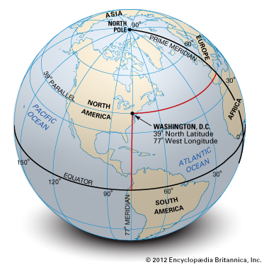
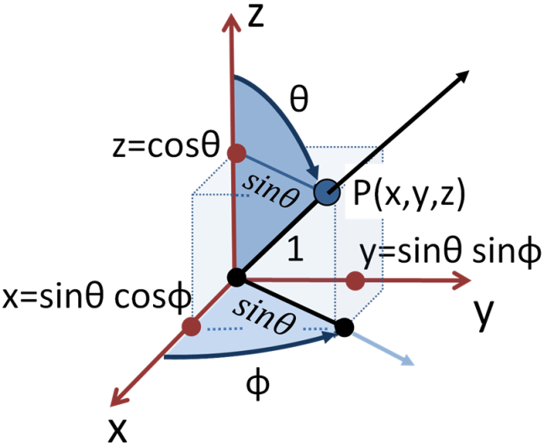
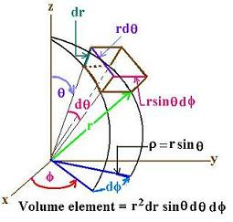
Recapitulation: Spherical Polar Co-ordinates
r:0 to ∞
θ: 0 to π
φ: 0 to 2π

Slide 7
Recapitulation: Schrodinger equation for the electronic part in Spherical Polar Co-ordinates

Slide 8
Recapitulation: The three independent equations
Radial
Angular
=β

Slide 9
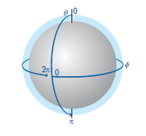
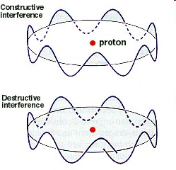
Solution to φ part
Trial solution:
Wavefunction has to be single valued
φ : 0 to 2π
Periodic Boundary Condition

Slide 10
Solution to φ part
cos (2πm) + i sin (2πm) = 1
z
True only if m=0, ±1, ±2, ±3, ±4,….
What kind of information does Φ contain?
x
Change in φ: Circular motion in xy plane
z – component of angular momentum?
y

Slide 11
Angular momentum: from classical to quantum picture
Is Φ an eigenfunction?

Slide 12
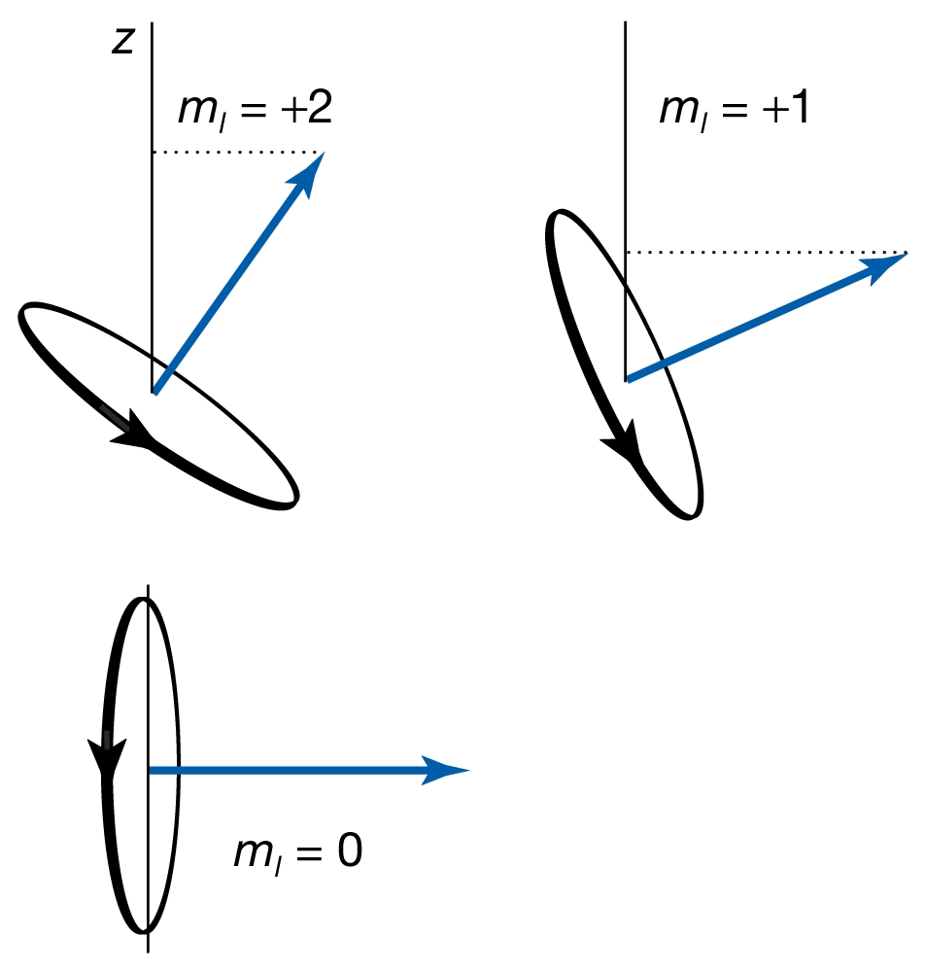
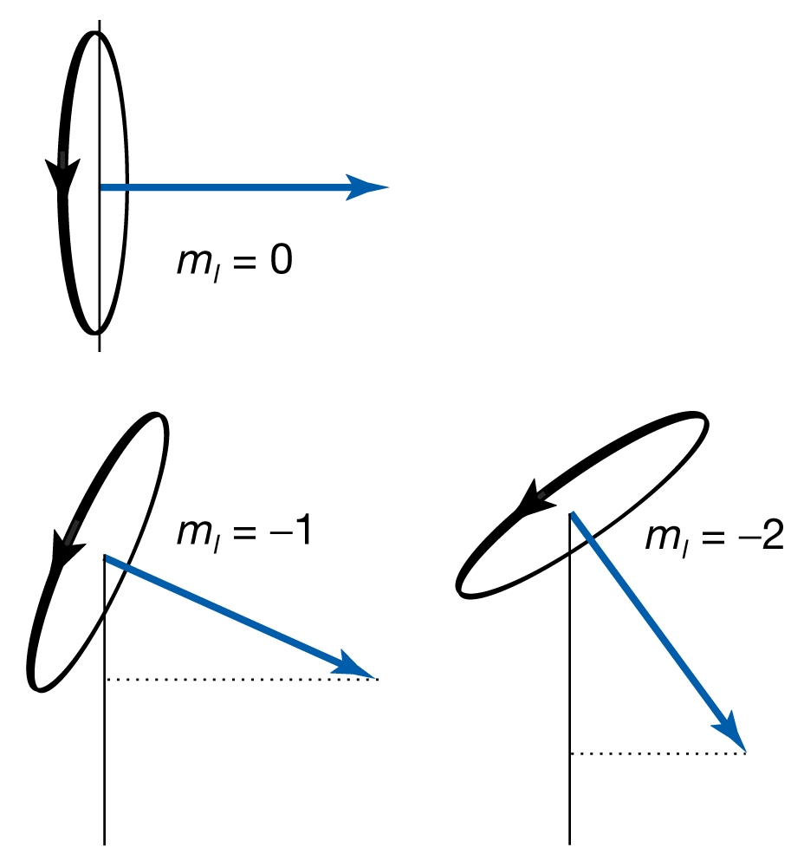
Moment of truth
z-component of angular momentum
m: Magnetic Quantum Number
“Space Quantization”

Slide 13
Solution to φ part: Magnetic quantum number
m=0, ±1, ±2, ±3, ±4,….
m is the magnetic quantum number
m is restricted by another quantum number (orbital Angular momentum), l, such that |m|<l

Slide 14
The Θ part
Θ(θ) =
: Associated Legendre Polynomials
Azimuthal quantum number l = 0,1,2,3…,
m≤l

Slide 15
The angular (Θ·Φ) part
The angular part of the solution
are called spherical harmonics
l=0,1,2,3…
m=0, ±1, ±2, ±3… and |m|≤l

Slide 16
The angular (Θ·Φ) part:
in spherical polar co-ords.
Angular
equation:
Multiply by

Slide 17
The angular (Θ·Φ) part:
in spherical polar co-ords.
Angular
equation:
Multiply by

Slide 18
The angular (Θ·Φ) part:
in spherical polar co-ords.
Angular
equation:
Multiply by

Slide 19
The angular (Θ·Φ) part:
in spherical polar co-ords.
Angular
equation:
Multiply by

Slide 20
The angular (Θ·Φ) part:
Total angular momentum
in spherical polar co-ords.
Angular
equation:
Multiply by

Slide 21
The R part
Solution to R(r) are
Restriction on l<n
Where are called associated Laguerre functions
The new quantum number is ‘n’ called principal quantum number

Slide 22
Energy of the Hydrogen Atom
Energy is dependent only on ‘n’
Energy obtained by full quantum mechanical treatment is equal to Bohr energy
Potential energy term is only dependent on the Radial part and has no contribution from the Angular parts

Slide 23
Quantum Numbers of Hydrogen Atom
n Principal Quantum number
Specifies the energy of the electron
l Orbital Angular Momentum Quantum number
Specifies the magnitude of the electron's orbital angular momentum
m Z-component of Angular Momentum Quantum number
Specifies the orientation of the electron's orbital angular momentum
S Spin Angular Momentum Quantum number
Specifies the orientation of the electron's spin angular momentum

